Slide 1
Basic Concepts

Slide 2
Software Architecture Definitions
There seems to be several definitions of Software Architecture ranging from specific to more design oriented ones …
The software architecture of a system is the set of structures needed to reason about the system, which comprise software elements, relations among them, and properties of both.
A software system’s architecture is the set of principal design decisions made about the system.

Slide 3
ANSI/IEEE Standard 1471-200
Architecture is the fundamental organization of a system, embodied in its components, their relationships to each other and the environment, and the principles governing its design and evolution.

Slide 4
Reference Architecture
In software projects you sometimes get developers and architects referring to the “Reference Architecture”
A reference architecture is the set of principal design decisions that are simultaneously applicable to multiple related systems, typically within an application domain, with explicitly deﬁned points of variation.
Design decisions on ….
Structure • non-functional requirements
Functional behavior • implementation
Interaction

Slide 5
Prescriptive vs Descriptive Architecture
A Prescriptive Architecture are those architectural decisions (P) that are made to achieve some intent of the system.
A Descriptive Architecture are those architectural decisions (D) that were made to realize the system.
Ideally P and D are the same but in many cases they differ.

Slide 6
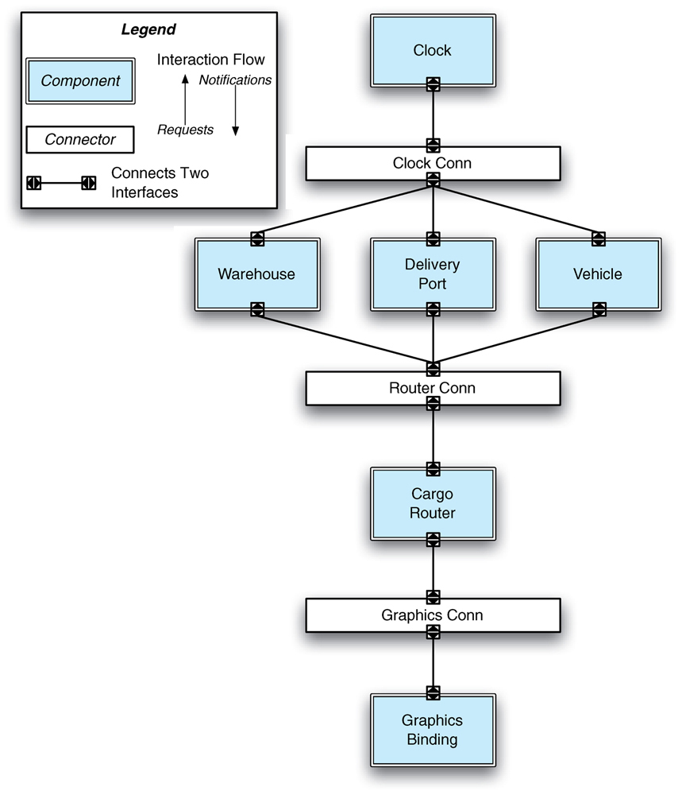
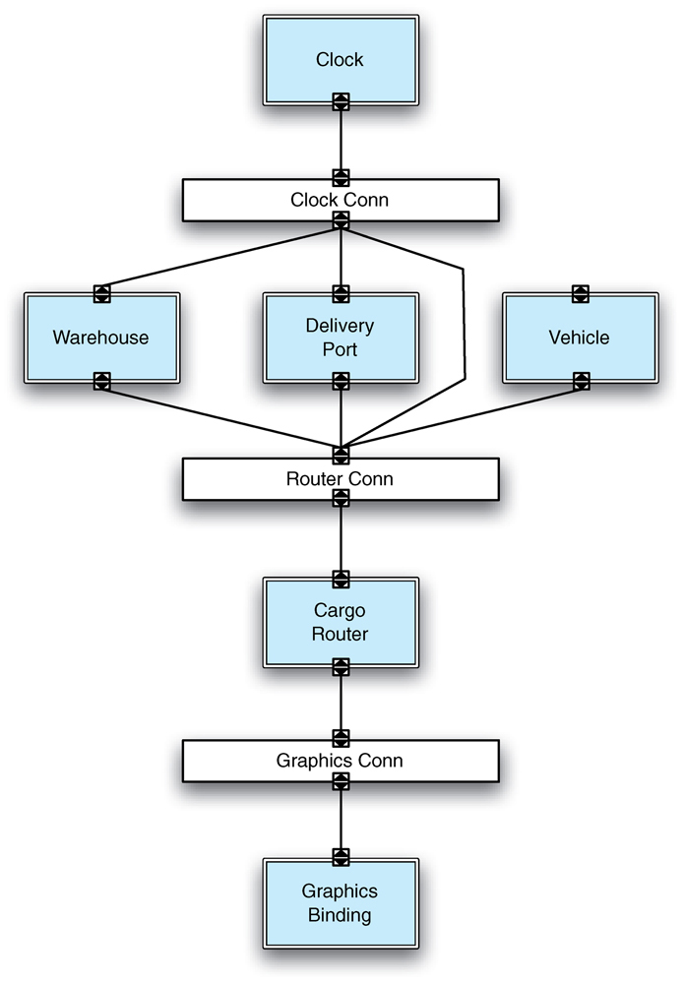
Prescriptive and Descriptive Example Cargo Delivery System
A direct connection was introduced
- This was not the intent
Prescriptive
Descriptive

Slide 7
Reasons why P&D may Differ
Developer sloppiness
Perception of short deadlines that prevent thinking through and documenting the impact on the prescriptive architecture
Lack of a documented prescriptive architecture
Need or desire to optimize the system “which can be done only in the code,”
Inadequate techniques and tool support.

Slide 8
Architectural Degradation
The difference between P&D is known as Architectural Degradation and is caused by:
Architectural Drift
Architectural Erosion
Architectural drift is introduction of principal design decisions into a system’s descriptive architecture that (a) are not included in, encompassed by, or implied by the prescriptive architecture, but which (b) do not violate any of the prescriptive architecture’s design decisions.
Architectural erosion is the introduction of architectural design decisions into a system’s descriptive architecture that violate its prescriptive architecture.

Slide 9
Example
In the previous example …
Architectural Drift: Introducing a link between the Clock and Router connectors will not necessarily violate P assuming that the system’s original architects did not explicitly prohibit the direct linking of two connectors.
Architectural Erosion: The removal of the link between the Vehicle component and its adjacent connector can violate P as it could lead to inability to synchronize the system and result in a delay in the delivery of the cargo.
This is alleviated by making certain that the developers discuss their decisions with the architect and the Prescriptive model is updated.

Slide 10
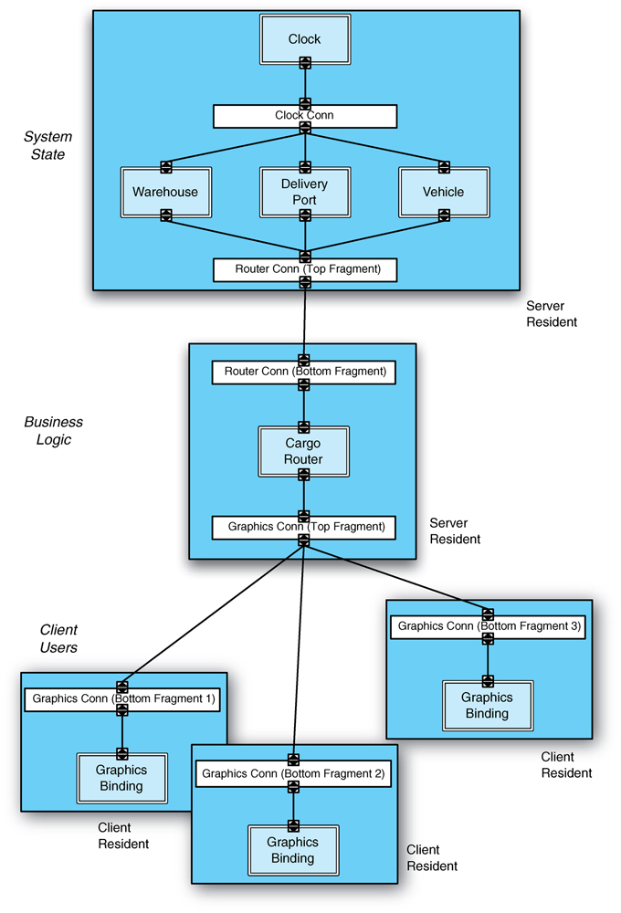
Deployment Perspective
The last example demonstrated a Structural Perspective of the Architecture.
System requirements are also affected by Deployment.
For example, placing many large components on a small device with limited memory and CPU power, or transferring high volumes of data over a network link with low bandwidth will negatively impact the system,

Slide 11
Software Component
A software component is an architectural entity that (1) encapsulates a subset of the system’s functionality and/or data, (2) restricts access to that subset via an explicitly deﬁned interface, and (3) has explicitly deﬁned dependencies on its required execution context.
Can Include:
The component’s required interface
The availability of speciﬁc resources
The required system software
The hardware conﬁgurations

Slide 12
Components vs. Objects
See the uploaded PDF file from Syntropy Limited that presents a good comparison.

Slide 13
Software Connector
A software connector is an architectural element tasked with effecting and regulating interactions among components.
Common types of Connectors
Procedure call
Shared data access
Distribution (used across distributed systems)
RPC, RMI,
Adaptor

Slide 14
Architectural Configuration
An architectural conﬁguration is a set of speciﬁc associations between the components and connectors of a software system’s architecture.
A conﬁguration may be represented as a graph wherein nodes represent components and connectors, and whose edges represent their associations (topology or interconnectivity).
Taylor’s Notation
UML Component
Box and Line

Slide 15
Architectural Pattern or Style
An architectural pattern is a named collection of architectural design decisions that are applicable to a recurring design problem, parameterized to account for different software development contexts in which that problem appears.
The author (Taylor et al.) tries to distinguish between architectural styles and patterns. We will not enforce make this distinction in this course.
These will be covered later in more detail but some examples are presented to illustrate the point.

Slide 16
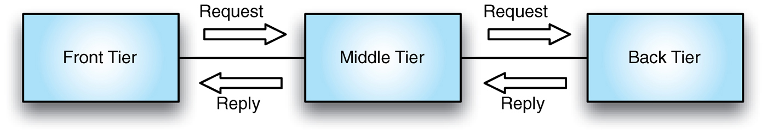
3-Tier Architecture
Very widely used in distributed systems where distributed users need to process, store, and retrieve signiﬁcant amounts of data.
All that the architect needs to specify is:
Application specific user interface (front tier), processing (middle tier), and data storage (back tier)
Which mechanisms should be used to enable interaction across the tiers (i.e. the connections).
Typically request-reply but others like synchronous, request-triggered, single-request–single-reply interaction are possible.

Slide 17
Software Architecture and Models
A software system’s architecture is captured in an architectural model using a particular modeling notation.
Models may vary in the amount of detail they capture, the speciﬁc architectural perspective they capture (for instance, structural versus behavioral, static versus dynamic, entire system versus a particular component or subsystem), the type of notation they use, and so forth
An architectural model is an artifact that captures some or all of the design decisions that comprise a system’s architecture. Architectural modeling is the reiﬁcation and documentation of those design decisions.

Slide 18
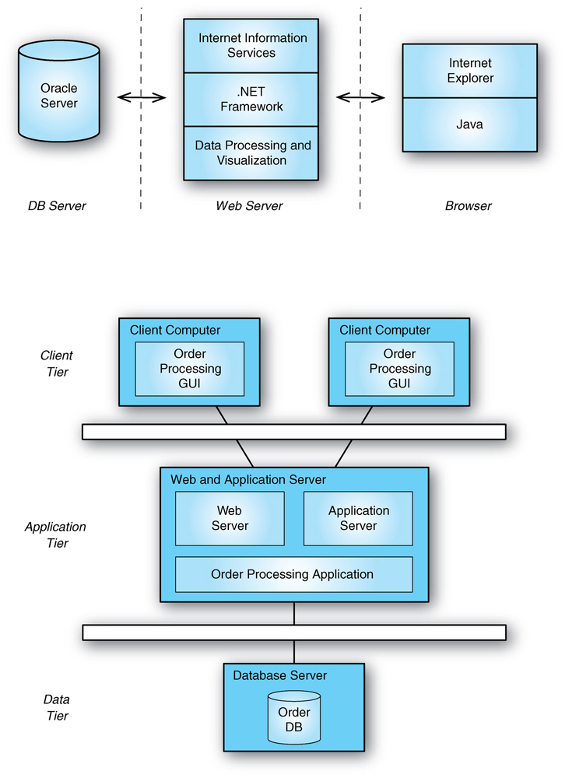
Two Different Notations
Architecture description languages (ADLs) can be textual or graphical, informal (such as PowerPoint diagrams), semi-formal, or formal, domain-speciﬁc or general-purpose, proprietary or standardized.
We will cover some of these later in the course.

Slide 19
In Class Exercise
Work on In-class exercises 1a and 1b

Slide 20
Introduction to Software Design

Slide 21
Preamble
Process of design involves the selection and adaptation of a number of solution approaches.
Is design “hard”? Well, yes and no.
Novel design is hard but incremental design is simpler.
Fortunately there are ample proven designs and design fragments, or building blocks that we call design concepts, that can be reused and combined to reliably achieve these goals.

Slide 22
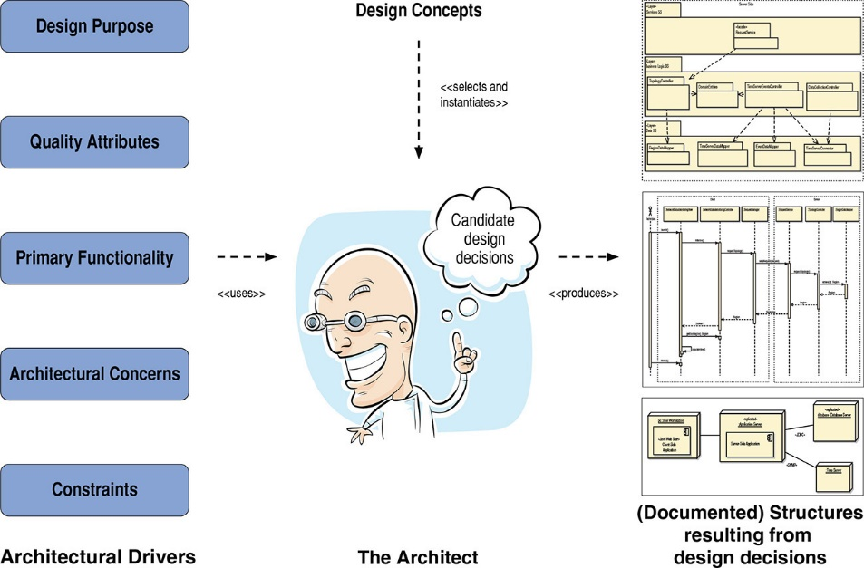
Role of the Software Architect
In general, when designing, a change in some structure to achieve one quality attribute will have negative effects on other quality attributes.
Thus the architect’s job is not one of finding an optimal solution, but rather one of satisficing.
Searching through a potentially large space of design alternatives and decisions until an acceptable solution is found

Slide 23
Sniffing Out Architecturally Significant Requirement (ASRs)

Slide 24
ASR Exercise
For the Cash Register Requirements use the ASR guideline to determine which requirements are ASR requirements.

Slide 25
Element Interaction Design
A decision is architectural if it has non-local consequences and those consequences matter to the achievement of an architectural driver.
During initial architectural design, the architect will focus on the primary functionality of the system, i.e the primary use cases.
There are many other non-primary use cases that are captured as interactions among elements and is known as element interaction design.
This is typically performed using sequence diagrams according to the decisions made during architectural design.
One cannot reason about interaction until several elements and some patterns of interactions among them have been defined.
These elements can be units of work (i.e., modules) assigned to an individual or to a team, so this level of design is important for defining not only how non-primary functionality is allocated, but also for planning purposes (e.g., team formation and communication, budgeting, outsourcing, release planning, unit and integration test planning).

Slide 26
Internal Entity Design
The architect should also be aware of the internal entity design, i.e. how an entity works internally.
Ensures that the system’s important quality attributes are not compromised
One cannot design an element’s internals until the elements themselves have been defined,

Slide 27
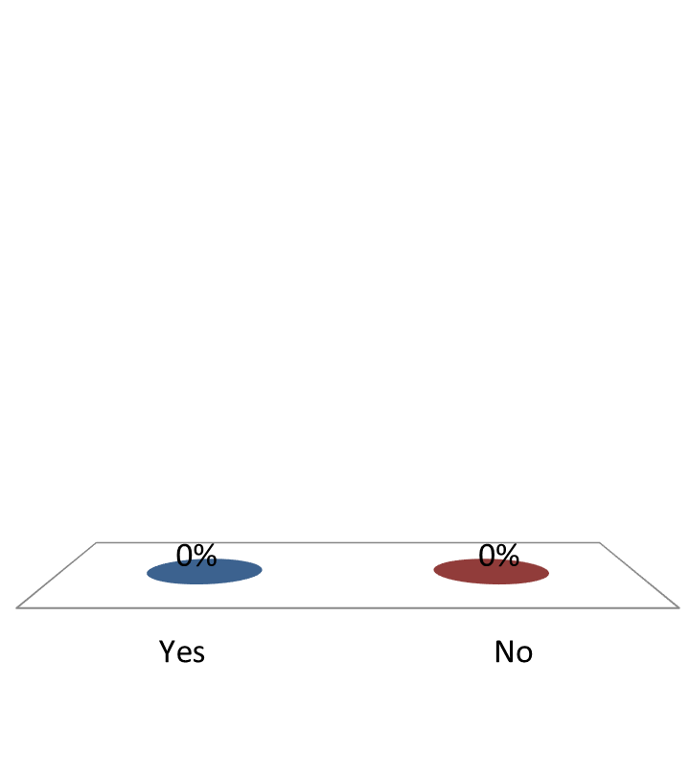
Do you understand the Difference between Interaction and Internal Design
Yes
No

Slide 28
Why is Software Architecture Important?

Slide 29
Why is Software Architecture Important?
Let’s go back and reflect on some of the more important points:
Without doing some architectural thinking and some early design work, you cannot confidently predict project cost, schedule, and quality.
An architecture will determine the key approaches for achieving architectural drivers, the gross work-breakdown structure, and the choices of tools, skills, and technologies needed to realize the system.
Architecture is a key enabler of agility
Without architecture, the benefits that the system is supposed to bring will be far harder to realize.
if you do not make some key architectural decisions early and if you allow your architecture to degrade, you will be unable to maintain sprint velocity, because you cannot easily respond to change requests.

Slide 30
Why is Software Architecture Important?
A well-designed, properly communicated architecture is key to achieving agreements that will guide the team
The most important kinds to make are agreements on interfaces and on shared resources.
These decisions will be made sooner or later and if you don’t make them in the early stage of design the system will be much more difficult to integrate.

Slide 31
What Makes a “Good” Architecture?
There is no such thing as an inherently good or bad architecture.
Architectures are either more or less fit for some purpose
Architectures can be evaluated but only in the context of specific stated goals.
There are, however, good rules of thumb.

Slide 32
Process “Rules of Thumb”
The architecture should be the product of a single architect or a small group of architects with an identified technical leader.
This approach gives the architecture its conceptual integrity and technical consistency.
This recommendation holds for Agile and open source projects as well as “traditional” ones.
There should be a strong connection between the architect(s) and the development team.
The architect (or architecture team) should base the architecture on a prioritized list of well-specified quality attribute requirements.
The architecture should be documented using views. The views should address the concerns of the most important stakeholders in support of the project timeline.
The architecture should be evaluated for its ability to deliver the system’s important quality attributes.
This should occur early in the life cycle and repeated as appropriate.
The architecture should lend itself to incremental implementation,
Create a “skeletal” system in which the communication paths are exercised but which at first has minimal functionality.

Slide 33
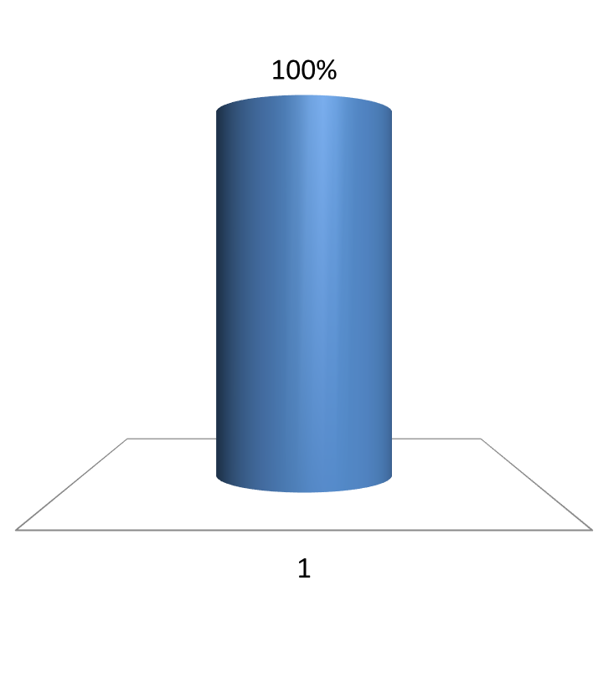
When creating a skeletal system what functionality of the system do you tend to focus on first?
Rank | Responses
1
2
3
4
5
6 | Other

Slide 34
Structural “Rules of Thumb”
The architecture should feature well-defined modules whose functional responsibilities are assigned on the principles of information hiding and separation of concerns.
The information-hiding modules should encapsulate things likely to change
Each module should have a well-defined interface that encapsulates or “hides” the changeable aspects from other software
Unless your requirements are unprecedented your quality attributes should be achieved using well-known architectural patterns and tactics specific to each attribute.
The architecture should never depend on a particular version of a commercial product or tool. If it must, it should be structured so that changing to a different version is straightforward and inexpensive.
Modules that produce data should be separate from modules that consume data.
This tends to increase modifiability
Changes are frequently confined to either the production or the consumption side of data.

Slide 35
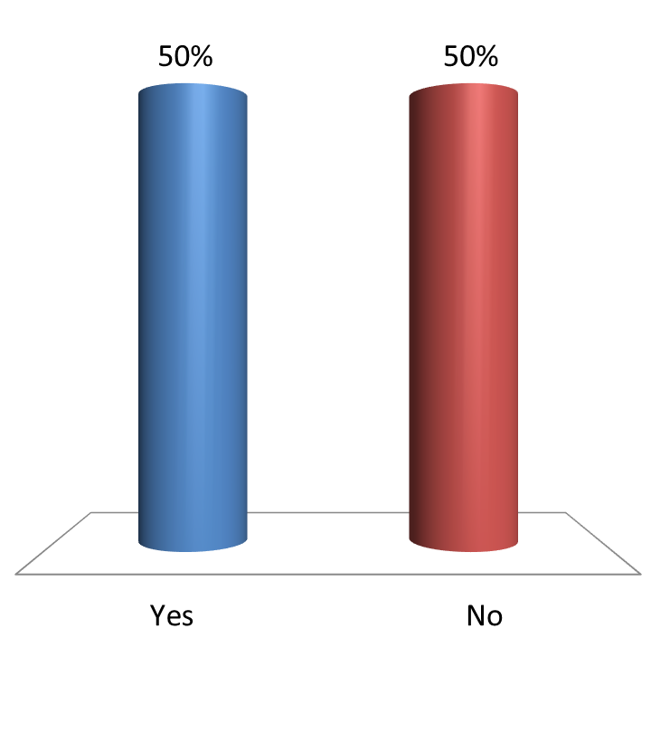
Does a 3 tier architecture embody the separation of concerns principle?
Yes
No

Slide 36
Structural “Rules of Thumb”
Don’t expect a one-to-one correspondence between modules and components.
Every process should be written so that its assignment to a specific processor can be easily changed, perhaps even at runtime.
The architecture should feature a small number of ways for components to interact.
The system should do the same things in the same way throughout.
This will aid in understandability, reduce development time, increase reliability, and enhance modifiability.
The architecture should contain a specific (and small) set of resource contention areas, the resolution of which is clearly specified and maintained.

Slide 37
Summary
The software architecture of a system is the set of structures needed to reason about the system, which comprise software elements, relations among them, and properties of both.
A structure is a set of elements and the relations among them.
A view is a representation of a coherent set of architectural elements. A view is a representation of one or more structures.

Slide 38
Summary
There are three categories of structures:
Module structures show how a system is to be structured as a set of code or data units that have to be constructed or procured.
Component-and-connector structures show how the system is to be structured as a set of elements that have runtime behavior (components) and interactions (connectors).
Deployment structures show how the system will relate to non-software structures in its environment (such as CPUs, file systems, networks, development teams, etc.).
Structures represent the primary engineering leverage points of an architecture.
Every system has a software architecture, but this architecture may be documented and disseminated, or it may not be.
There is no such thing as an inherently good or bad architecture. Architectures are either more or less fit for some purpose.

